Slide 1
Airbnb service
Tidy touch housekeeping maidstone

Slide 2
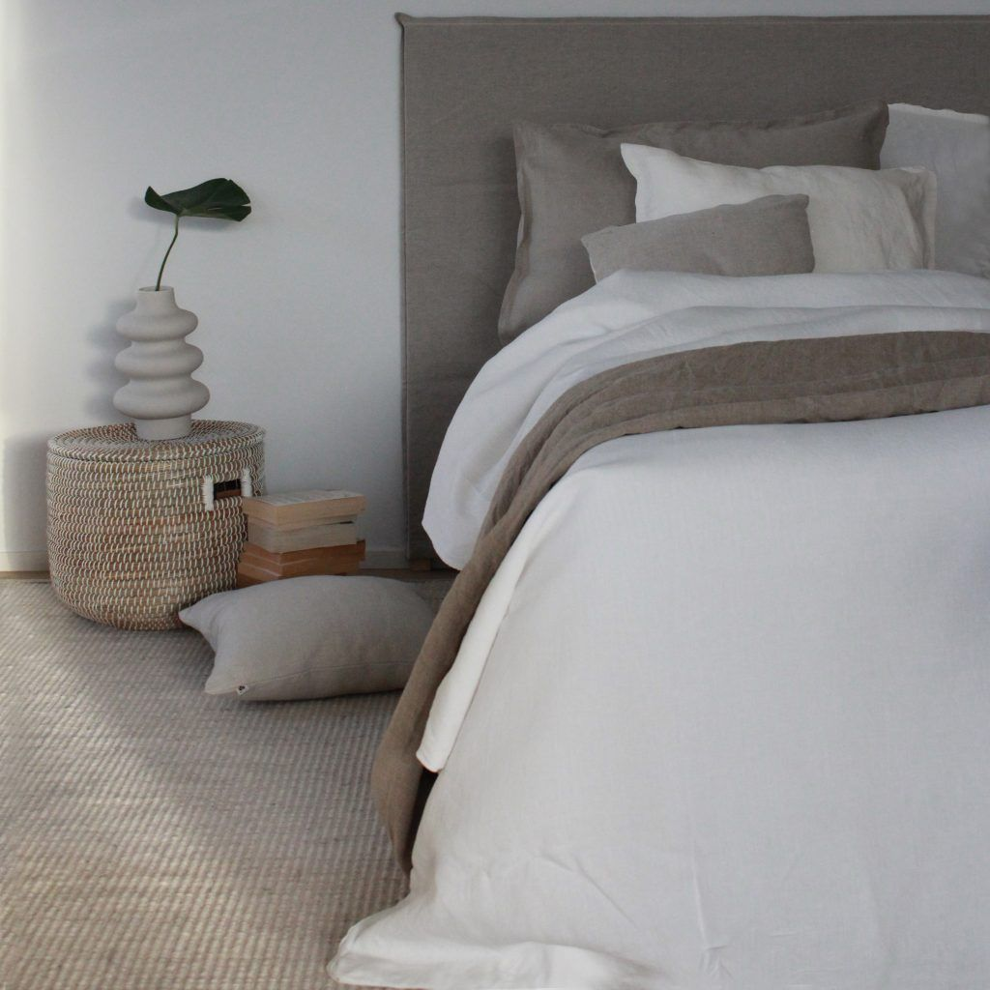
Linen hire
Single bed pack £15​
​
1x Single Sheet​
1x Single Duvet cover​
2x Pillows Cases
1x Hand Towel​
1x Bath Towel​
Double bed pack £16​
​
1x Double Sheet​
1x Double Duvet Cover​
4x Pillows Cases​
2x Hand Towels​
2x Bath Towels​
King bed pack £17​
​
1x King Sheet​
1x King Duvet Cover​
4x Pillow Cases​
2x Hand Towels​
2x Bath Towels​
Super King bed pack £20​
​
1x Super King Sheet​
1x Super King Duvet Cover​
4x Pillow Cases​
2x Hand Towels​
2x Bath Towels​
Linen hire policy
https://www.tidytouchmaidstone.co.uk/policy-linen-hire
(Please note the Linen hire policy can be customised)

Slide 3
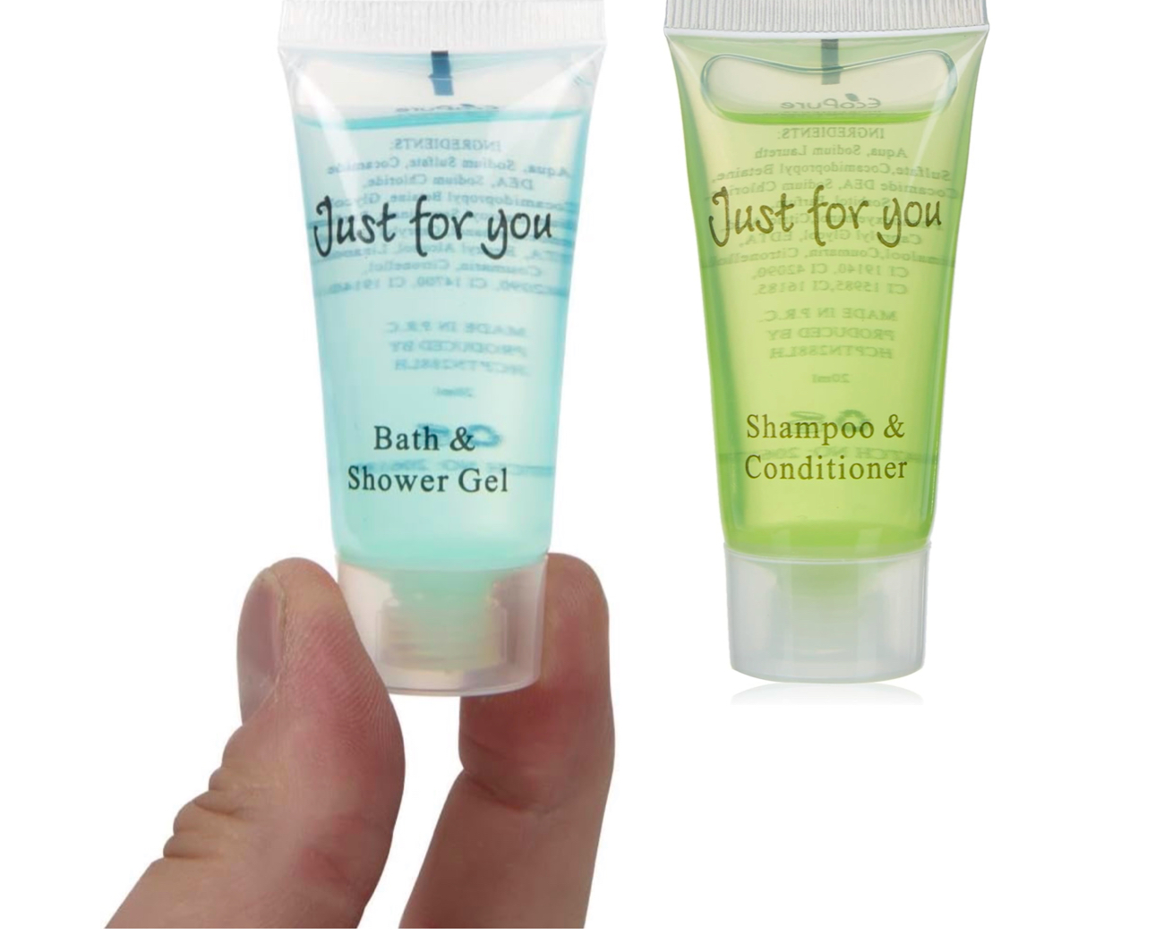
Just for you
1 Bath and shower gel +
1 Shampoo and conditioner
£1.50

Slide 4
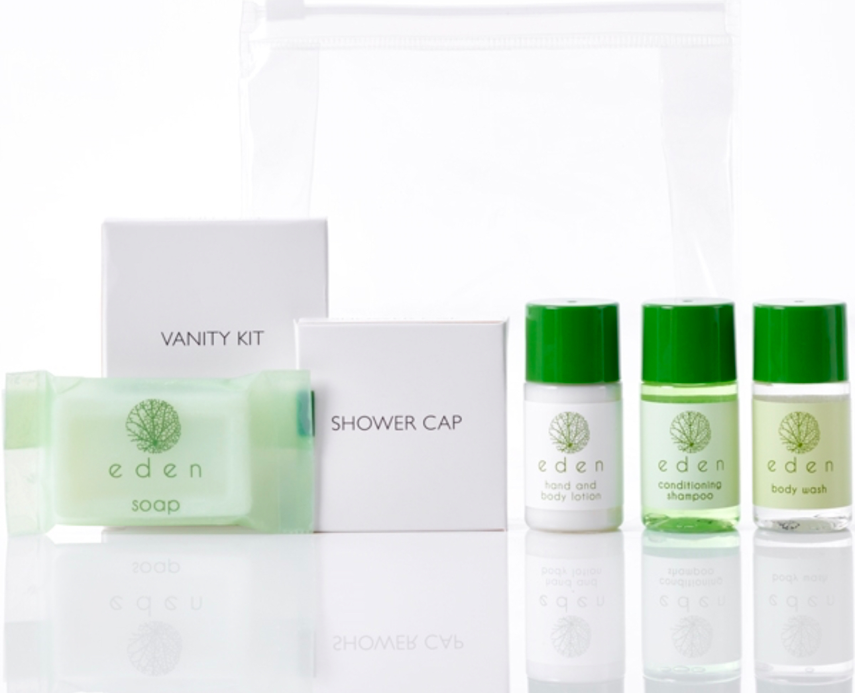
Eden Toiletries & Amenities Welcome Pack
Each pack contains 20ml bottles of conditioning shampoo, body wash and hand and body lotion infused with citrus fruits and cardamom for a nourishing cleanse.
A 20g flow-wrapped round hard soap, shower cap and vanity kit are also included.
Contents provided in a clear, waterproof zipped bag for your guests’ convenience and a smart display.
Eden hotel toiletries are made exclusively for Out of Eden using vegan and cruelty-free ingredients that are dermatologically tested.
£5

Slide 5
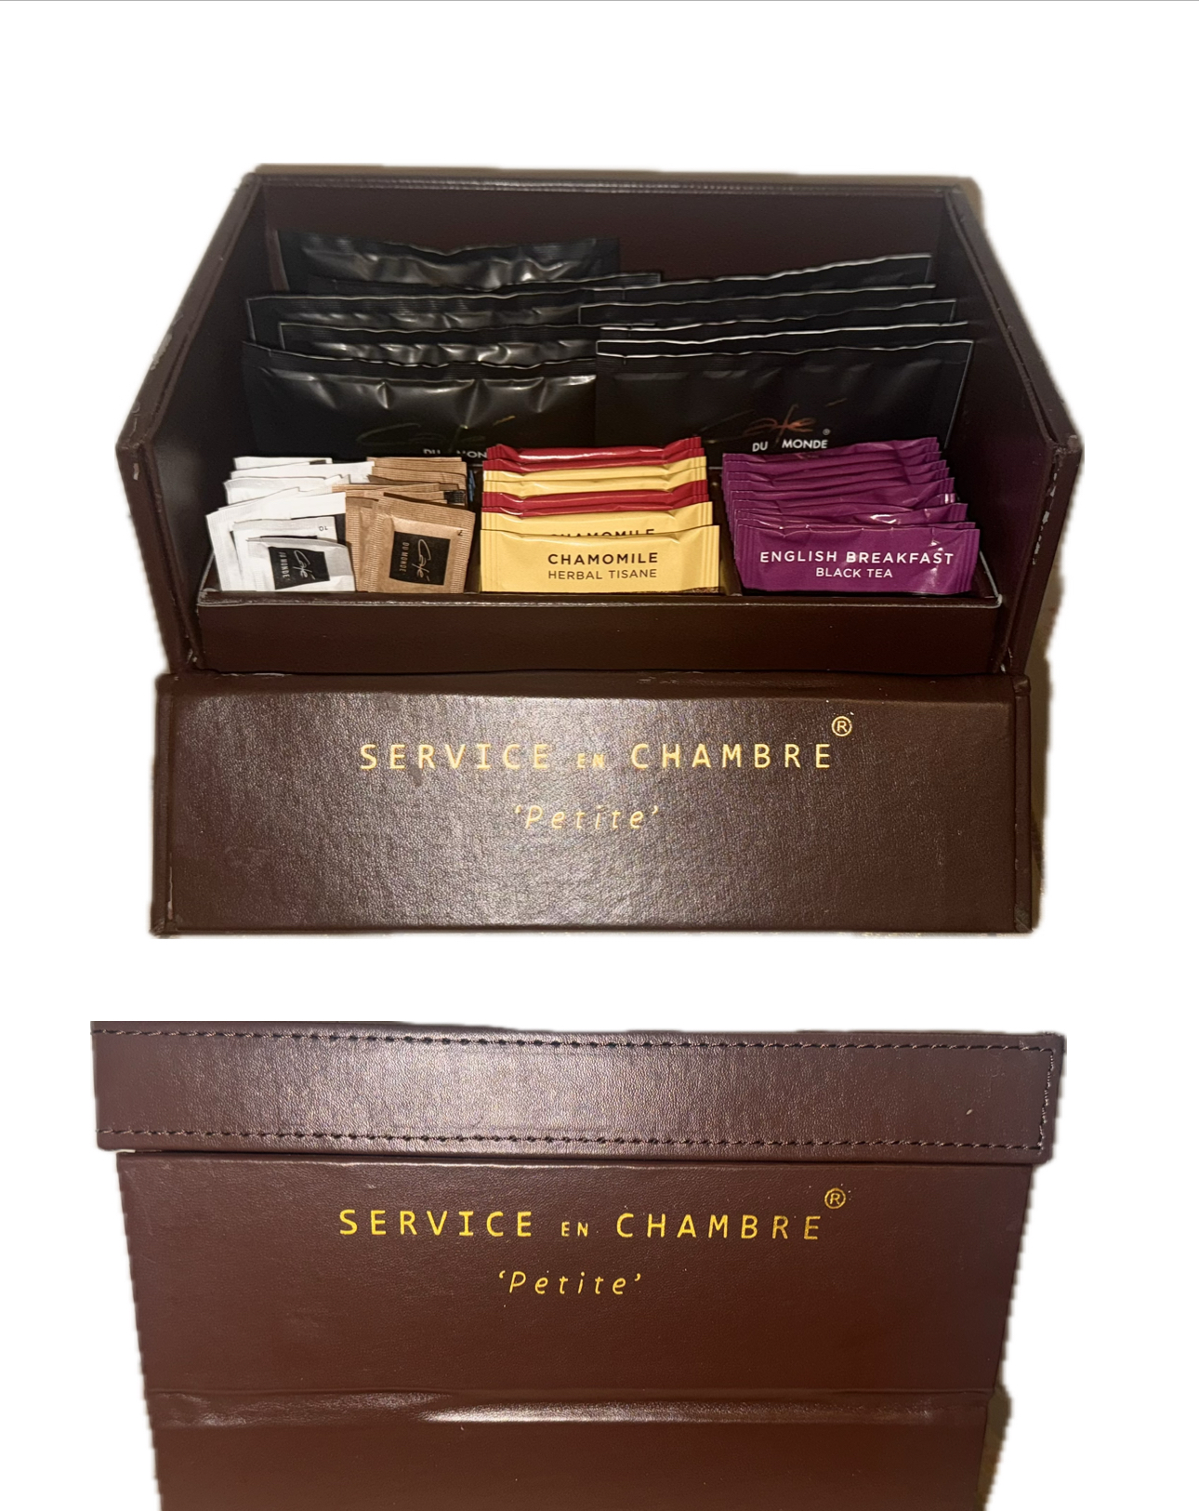
refreshment
Welcome pack shop
11 white sugar
11 brown sugar
5 coffee in a bag
5 coffee in a bag decaf
10 English breakfast tea
4 chamomile tea
4 summer berries tea
3 decaf tea
£12
*Please note the brown box is free to use and need to be given back once the service has finished.

